Slide 1

Management
Fourteenth Edition
Chapter MH-1
Management History Module
Copyright © 2018, 2016, 2014 Pearson Education, Inc. All Rights Reserved

Slide 2
Learning Objectives
MH1.1 Describe some early management examples.
MH1.2 Explain the various theories in the classical approach.
MH1.3 Discuss the development and uses of the behavioral approach.
MH1.4 Describe the quantitative approach.
MH1.5 Explain various theories in the contemporary approach.

Slide 3
Early Management
The Egyptian pyramids and the Great Wall of China are proof that projects of tremendous scope, employing tens of thousands of people, were completed in ancient times.
Notes:
Who told each worker what to do? Who ensured there would be enough stones at the site to keep workers busy? The answer is managers. Someone had to plan what was to be done, organize people and materials to do it, make sure those workers got the work done, and impose some controls to ensure that everything was done as planned.

Slide 4
Job Specialization
In 1776 Adam Smith published “The Wealth of Nations”
division of labor (job specialization): the breakdown of jobs into narrow and repetitive tasks
Notes:
Smith concluded that division of labor increased productivity by increasing each worker’s skill and dexterity, saving time lost in changing tasks and creating labor-saving inventions and machinery.

Slide 5
Industrial Revolution
Industrial revolution: a period during the late eighteenth century when machine power was substituted for human power, making it more economical to manufacture goods in factories than at home
Notes:
Starting in the late eighteenth century when machine power was substituted for human power, a point in history known as the industrial revolution, it became more economical to manufacture goods in factories rather than at home. These large efficient factories needed someone to forecast demand, ensure that enough material was on hand to make products, assign tasks to people, direct daily activities, and so forth.

Slide 6
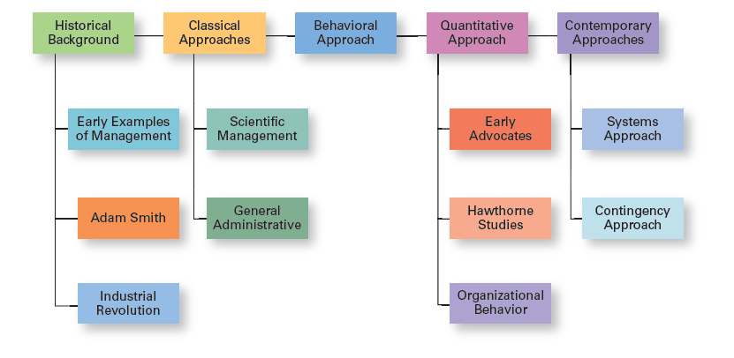
Exhibit MH-1 Major Approaches to Management
Exhibit MH-1 shows the four major approaches to management theory: classical, behavioral, quantitative, and contemporary.
Notes:
In this module, we’ll look at four major approaches to management theory: classical, behavioral, quantitative, and contemporary (see Exhibit MH-1). Keep in mind that each approach is concerned with trying to explain management from the perspective of what was important at that time in history and the backgrounds and interests of the researchers. Each of the four approaches contributes to our overall understanding of management, but each is also a limited view of what it is and how to best practice it.

Slide 7
Classical Approach
Classical approach: first studies of management, which emphasized rationality and making organizations and workers as efficient as possible
Notes:
The first studies of management, often called the classical approach, emphasized rationality and making organizations and workers as efficient as possible. Two major theories comprise the classical approach: scientific management and general administrative theory. The two most important contributors to scientific management theory were Frederick W. Taylor and the husband–wife team of Frank and Lillian Gilbreth. The two most important contributors to general administrative theory were Henri Fayol and Max Weber. Let’s take a look at each of these important figures in management history.

Slide 8
Scientific Management
Scientific management: an approach that involves using the scientific method to find the “one best way” for a job to be done
Notes:
If you had to pinpoint when modern management theory was born, 1911 might be a good choice. That was when Frederick Winslow Taylor’s Principles of Scientific Management was published. Its contents were widely embraced by managers around the world. Taylor’s book described the theory of scientific management—the use of scientific methods to define the “one best way” for a job to be done.

Slide 9
Exhibit MH-2 Taylor’s Scientific Management Principles
Principles
1. Develop a science for each element of an individual’s work to replace the old rule-of-thumb method.
2. Scientifically select and then train, teach, and develop the worker.
3. Heartily cooperate with the workers to ensure that all work is done in accordance with the principles of the science that has been developed.
4. Divide work and responsibility almost equally between management and workers. Management does all work for which it is better suited than the workers.
Notes:
Taylor’s experiences at Midvale led him to define clear guidelines for improving production efficiency. He argued that these four principles of management (see Exhibit MH-2) would result in prosperity for both workers and managers.
Source: F. W. Taylor, Principles of Scientific Management (New York: Harper, 1911).

Slide 10
Frank and Lillian Gilbreth
Therbligs: a classification scheme for labeling basic hand motions
Notes:
Taylor’s most prominent followers were Frank and Lillian Gilbreth. Frank and his wife Lillian, a psychologist, studied work to eliminate inefficient hand-and-body motions. The Gilbreths also experimented with the design and use of the proper tools and equipment for optimizing work performance.
The Gilbreths also devised a classification scheme to label 17 basic hand motions (such as search, grasp, hold), which they called therbligs (Gilbreth spelled backward with the th transposed). This scheme gave the Gilbreths a more precise way of analyzing a worker’s exact hand movements.
Many of the guidelines and techniques Taylor and the Gilbreths devised for improving production efficiency are still used in organizations today. Nowadays, adaptive robotics can help boost worker efficiency. By freeing workers from repetitive tasks, one study revealed that workers could complete essential tasks requiring manual dexterity 25 percent faster.

Slide 11
General Administrative Theory
General administrative theory: an approach to management that focuses on describing what managers do and what constitutes good management practice
Notes:
Fayol wrote during the same time period as Taylor. While Taylor was concerned with first-line managers and the scientific method, Fayol’s attention was directed at the activities of all managers. He wrote from his personal experience as the managing director of a large French coal-mining firm.

Slide 12
Henri Fayol
Principles of management: fundamental rules of management that could be applied in all organizational situations and taught in schools
Notes:
Henri Fayol described the practice of management as something distinct from accounting, finance, production, distribution, and other typical business functions. His belief that management was an activity common to all business endeavors, government, and even the home, led him to develop 14 principles of management—fundamental rules of management that could be applied to all organizational situations and taught in schools. These principles are shown in Exhibit MH-3.

Slide 13
Exhibit MH-3: Fayol’s 14 Principles of Management (1 of 2)
Principles
1. Division of work. Specialization increases output by making employees more efficient.
2. Authority. Managers must be able to give orders, and authority gives them this right.
3. Discipline. Employees must obey and respect the rules that govern the organization.
4. Unity of command. Every employee should receive orders from only one superior.
5. Unity of direction. The organization should have a single plan of action to guide managers and workers.
6. Subordination of individual interests to the general interest. The interests of any one employee or group of employees should not take precedence over the interests of the organization as a whole.
7. Remuneration. Workers must be paid a fair wage for their services.
Notes:
Source: Based on Henri Fayol’s 1916 Principles of Management, “Administration Industrielle et Générale,” translated by C. Storrs, General and Industrial Management (London: Sir Isaac Pitman & Sons, London, 1949).

Slide 14
Exhibit MH-3: Fayol’s 14 Principles of Management (2 of 2)
Principles
8. Centralization. This term refers to the degree to which subordinates are involved in decision making.
9. Scalar chain. The line of authority from top management to the lowest ranks is the scalar chain.
10. Order. People and materials should be in the right place at the right time.
11. Equity. Managers should be kind and fair to their subordinates.
12. Stability of tenure of personnel. Management should provide orderly personnel planning and ensure that replacements are available to fill vacancies.
13. Initiative. Employees allowed to originate and carry out plans will exert high levels of effort.
14. Esprit de corps. Promoting team spirit will build harmony and unity within the organization.
Notes:
Source: Based on Henri Fayol’s 1916 Principles of Management, “Administration Industrielle et Générale,” translated by C. Storrs, General and Industrial Management (London: Sir Isaac Pitman & Sons, London, 1949).

Slide 15
Max Weber
Bureaucracy: a form of organization characterized by division of labor, a clearly defined hierarchy, detailed rules and regulations, and impersonal relationships
Notes:
Max Weber (pronounced VAY-ber) was a German sociologist who studied organizations. Writing in the early 1900s, he developed a theory of authority structures and relations based on an ideal type of organization he called a bureaucracy—a form of organization characterized by division of labor, a clearly defined hierarchy, detailed rules and regulations, and impersonal relationships (see Exhibit MH-4).
Weber recognized that this “ideal bureaucracy” didn’t exist in reality. Instead, he intended it as a basis for theorizing about how work could be done in large groups. His theory became the structural design for many of today’s large organizations.

Slide 16
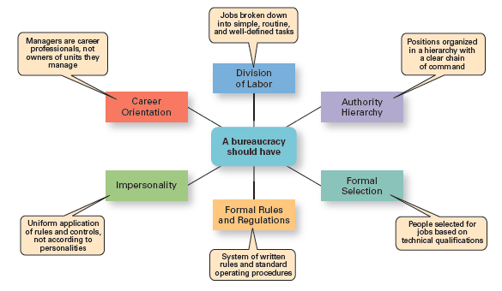
Exhibit MH-4 Characteristics of Weber’s Bureaucracy
Exhibit MH-4 shows Weber’s ideal bureaucracy.
Notes:
Source: Based on Essays in Sociology by Max Weber, translated, edited, and introduced by H. H. Gerth and C. Wright Mills (NewYork: Oxford University Press, 1946).

Slide 17
Behavioral Approach
Organizational behavior (OB): the study of the actions of people at work
Notes:
The field of study that researches the actions (behavior) of people at work is called organizational behavior (OB). Much of what managers do today when managing people—motivating, leading, building trust, working with a team, managing conflict, and so forth—has come out of OB research.
Although a number of individuals in the early twentieth century recognized the importance of people to an organization’s success, four stand out as early advocates of the OB approach: Robert Owen, Hugo Munsterberg, Mary Parker Follett, and Chester Barnard. Their contributions were varied and distinct, yet all believed that people were the most important asset of the organization and should be managed accordingly.

Slide 18
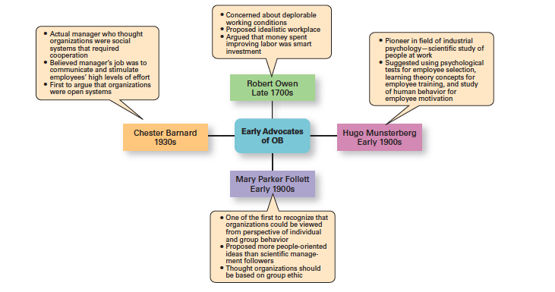
Exhibit MH-5 Early OB Advocates
Exhibit MH- 5 summarizes each individual’s most important ideas.
Notes:
Although a number of individuals in the early twentieth century recognized the importance of people to an organization’s success, four stand out as early advocates of the OB approach: Robert Owen, Hugo Munsterberg, Mary Parker Follett, and Chester Barnard. Their contributions were varied and distinct, yet all believed that people were the most important asset of the organization and should be managed accordingly. Their ideas provided the foundation for such management practices as employee selection procedures, motivation programs, and work teams. Exhibit MH-5 summarizes each individual’s most important ideas.

Slide 19
Hawthorne Studies
Hawthorne studies: a series of studies during the 1920s and 1930s that provided new insights into individual and group behavior
Notes:
Scholars generally agree that the Hawthorne Studies had a game-changing impact on management beliefs about the role of people in organizations. Elton Mayo conducted the Hawthorne Studies, a series of studies during the 1920s and 1930s that provided new insights into individual and group behavior. The studies concluded that people’s behavior and attitudes are closely related, that group factors significantly affect individual behavior, that group standards establish individual worker output, and that money is less a factor in determining output than group standards, group attitudes, and security. These conclusions led to a new emphasis on the human behavior factor in the management of organizations.

Slide 20
Quantitative Approach
Quantitative approach: the use of quantitative techniques to improve decision-making
Notes:
The quantitative approach is the use of quantitative techniques to improve decision making. This approach also is known as management science. The quantitative approach evolved from mathematical and statistical solutions developed for military problems during World War II. After the war was over, many of these techniques used for military problems were applied to businesses.

Slide 21
Total Quality Management
Total quality management (TQM): a philosophy of management that is driven by continuous improvement and responsiveness to customer needs and expectations
Notes:
Another area where quantitative techniques are used frequently is in total quality management. A quality revolution swept through both the business and public sectors in the 1980s and 1990s. It was inspired by a small group of quality experts; the most famous was W. Edwards Deming (pictured above) and Joseph M. Juran. The ideas and techniques they advocated in the 1950s had few supporters in the United States but were enthusiastically embraced by Japanese organizations. As Japanese manufacturers began beating U.S. competitors in quality comparisons, however, Western managers soon took a more serious look at Deming’s and Juran’s ideas, which became the basis for today’s quality management programs.
Total quality management, or TQM, is a management philosophy devoted to continual improvement and responding to customer needs and expectations (see Exhibit MH-6). The term customer includes anyone who interacts with the organization’s product or services, internally or externally. It encompasses employees and suppliers as well as the people who purchase the organization’s goods or services.

Slide 22
Exhibit MH-6: What is Quality Management?
Characteristic
1. Intense focus on the customer. The customer includes outsiders who buy the organization’s products or services and internal customers who interact with and serve others in the organization.
2. Concern for continual improvement. Quality management is a commitment to never being satisfied. “Very good” is not good enough. Quality can always be improved.
3. Process focused. Quality management focuses on work processes as the quality of goods and services is continually improved.
4. Improvement in the quality of everything the organization does. This relates to the final product, how the organization handles deliveries, how rapidly it responds to complaints, how politely the phones are answered, and the like.
5. Accurate measurement. Quality management uses statistical techniques to measure every critical variable in the organization’s operations. These are compared against standards to identify problems, trace them to their roots, and eliminate their causes.
6. Empowerment of employees. Quality management involves the people on the line in the improvement process. Teams are widely used in quality management programs as empowerment vehicles for finding and solving problems.

Slide 23
Contemporary Approaches
System: a set of interrelated and interdependent parts arranged in a manner that produces a unified whole
Closed systems: systems that are not influenced by and do not interact with their environment
Open systems: systems that interact with their environment
Notes:
Most of these earlier approaches focused on managers’ concerns inside the organization. Starting in the 1960s, management researchers began to look at what was happening in the external environment outside the boundaries of the organization. Two contemporary management perspectives—systems and contingency—are part of this approach. Systems theory is a basic theory in the physical sciences, but had never been applied to organized human efforts.
A system is a set of interrelated and interdependent parts arranged in a manner that produces a unified whole. The two basic types of systems are closed and open. Closed systems are not influenced by and do not interact with their environment. In contrast, open systems are influenced by and do interact with their environment. Today, when we describe organizations as systems, we mean open systems.

Slide 24
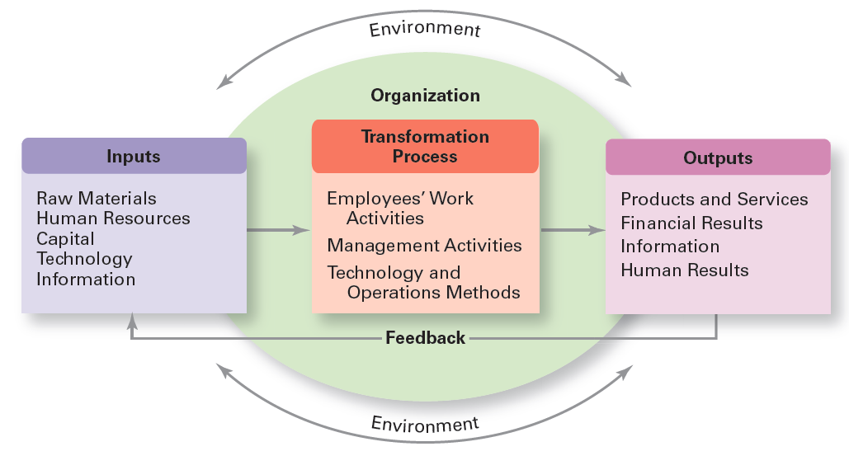
Exhibit MH-7 Organization as an Open System
Exhibit MH-7 shows a diagram of an organization from an open systems perspective.
Notes:
As you can see, an organization takes in inputs (resources) from the environment and transforms or processes these resources into outputs that are distributed into the environment. The organization is “open” to and interacts with its environment.

Slide 25
Contingency Approach
Contingency approach: a management approach that recognizes organizations as different, which means they face different situations (contingencies) and require different ways of managing
Notes:
Different and changing situations require managers to use different approaches and techniques. The contingency approach (sometimes called the situational approach) says that organizations are different, face different situations (contingencies), and require different ways of managing.

Slide 26
Exhibit MH-8: Popular Contingency Variables
Variable
Organization Size. As size increases, so do the problems of coordination. For in- stance, the type of organization structure appropriate for an organization of 50,000 employees is likely to be inefficient for an organization of 50 employees.
Routineness of Task Technology. To achieve its purpose, an organization uses technology. Routine technologies require organizational structures, leadership styles, and control systems that differ from those required by customized or nonroutine technologies.
Environmental Uncertainty. The degree of uncertainty caused by environmental changes influences the management process. What works best in a stable and predictable environment may be totally inappropriate in a rapidly changing and unpredictable environment.
Individual Differences. Individuals differ in terms of their desire for growth, autonomy, tolerance of ambiguity, and expectations. These and other individual differences are particularly important when managers select motivation techniques, leadership styles, and job designs.
Notes:
Exhibit MH-8 describes four popular contingency variables. Although the list is by no means comprehensive—more than 100 different variables have been identified—it represents those most widely used and gives you an idea of what we mean by the term contingency variable. The primary value of the contingency approach is that it stresses there are no simplistic or universal rules for managers to follow.

Slide 27
Review Learning Objective MH1.1
Describe some early management examples.
Early examples of management practice include the construction of the Egyptian pyramids and the Great Wall of China.
One important historical event was the publication of Adam Smith’s “Wealth of Nations,” in which he argued the benefits of division of labor (job specialization).
Another was the industrial revolution, where it became more economical to manufacture in factories than at home.

Slide 28
Review Learning Objective MH1.2
Explain the various theories in the classical approach.
Frederick W. Taylor
The Gilbreths
Henri Fayol
Max Weber
Notes:
Frederick W. Taylor, known as the “father” of scientific management, studied manual work using scientific principles—that is, guidelines for improving production efficiency—to find the one best way to do those jobs. The Gilbreths’ primary contribution was finding efficient hand-and-body motions and designing proper tools and equipment for optimizing work performance. Fayol believed the functions of management were common to all business endeavors but also were distinct from other business functions. Weber described an ideal type of organization he called a bureaucracy—characteristics that many of today’s large organizations still have.

Slide 29
Review Learning Objective MH1.3
Discuss the development and uses of the behavioral approach.
Early advocates of OB
The Hawthorne Studies
Notes:
Programmed decisions are repetitive decisions that can be handled by a routine approach and are used when the problem being resolved is straightforward, familiar, and easily defined (structured). Nonprogrammed decisions are unique decisions that require a custom-made solution and are used when the problems are new or unusual (unstructured) and for which information is ambiguous or incomplete.

Slide 30
Review Learning Objective MH1.4
Describe the quantitative approach.
The quantitative approach
Total quality management (TQM)
Notes:
The quantitative approach involves applications of statistics, optimization models, information models, and computer simulations to management activities. Today’s managers use the quantitative approach, especially when making decisions, as they plan and control work activities such as allocating resources, improving quality, scheduling work, or determining optimum inventory levels. Total quality management—a management philosophy devoted to continual improvement and responding to customer needs and expectations—also makes use of quantitative methods to meet its goals.

Slide 31
Review Learning Objective MH1.5
Explain various theories in the contemporary approach.
Systems approach
Contingency approach
Notes:
The systems approach says that an organization takes in inputs (resources) from the environment and transforms or processes these resources into outputs that are distributed into the environment.
The contingency approach says that organizations are different, face different situations, and require different ways of managing. It helps us understand management because it stresses there are no simplistic or universal rules for managers to follow.

Slide 32

Copyright

